Slide 1
INNOVATION
in
GOVERNANCE

Slide 2
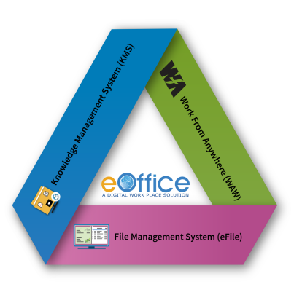
Files, Receipts, Letters and Documents – Most important assets in an organisation
The manual system of file processing has several challenges
Governments produce and manage immense volumes of documents.
Leading to delays in implementation of Government programmes & Schemes

Slide 3
Challenges of Manual System
Searching, retrieving and tracking of files
Storage and Secure Preservation of files
Intra/Inter departmental file movement delays
Vulnerable – fire, flood, insects, rats, fungus etc
Loss of Physical Files
Multiple copies of documents (Circulars/Notices)

Slide 4
A Digital Workplace Solution
Evolving since 2009

Slide 5
Based on Central Secretariat Manual of eOffice Procedure (CSMeOP), DARPG, GoI
Built on Open Source Software Stack
Enhances Efficiency, Transparency, & Accountability
Generic Design :
Single Product for Government at all levels
Promotes less paper office with greater collaboration and knowledge sharing
Fast Tracking
Government Decision Making

Slide 6
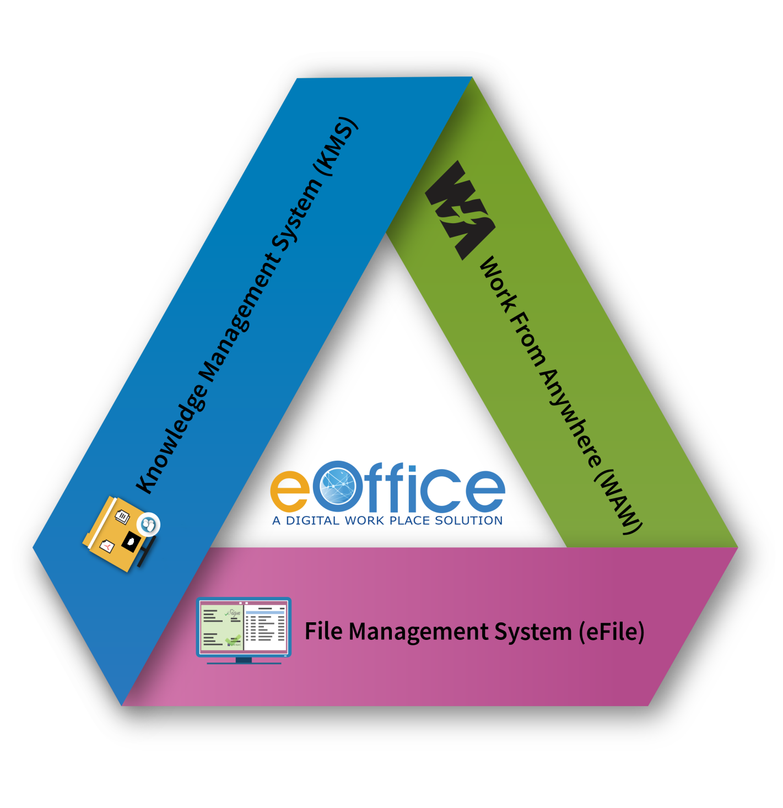
Components

Slide 7
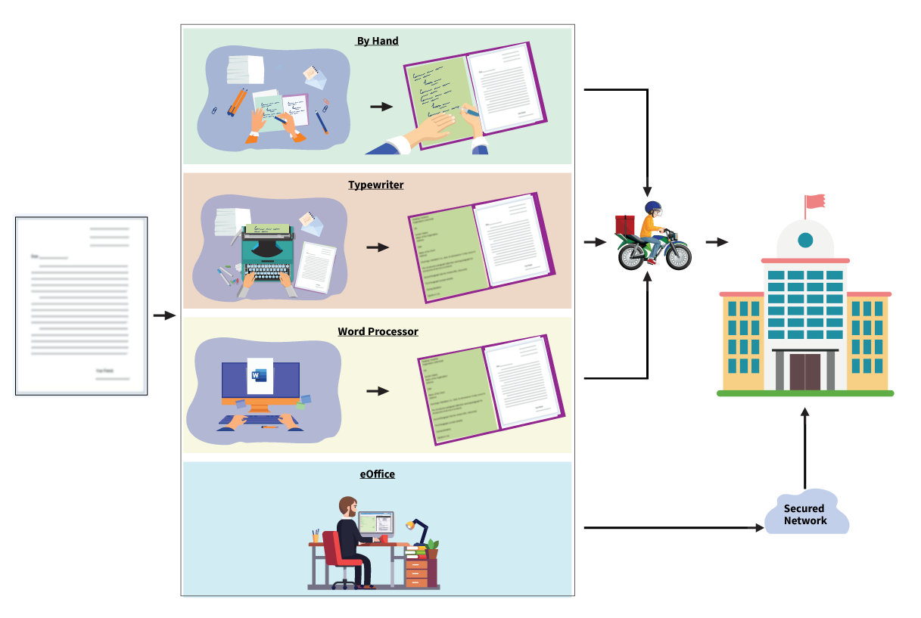
Transformational Journey
File Preparation …..

Slide 8
File Management System (eFile)
Workflow based System
Diarization of inward receipts/letters
Creation of files, noting and draft for approvals
Intra/Inter-departmental movement of files/receipts
Digital signing of noting and drafts using DSC/eSign
Searching of files/receipts/dispatch
Closing of files/receipts
Interfaces with external applications

Slide 9
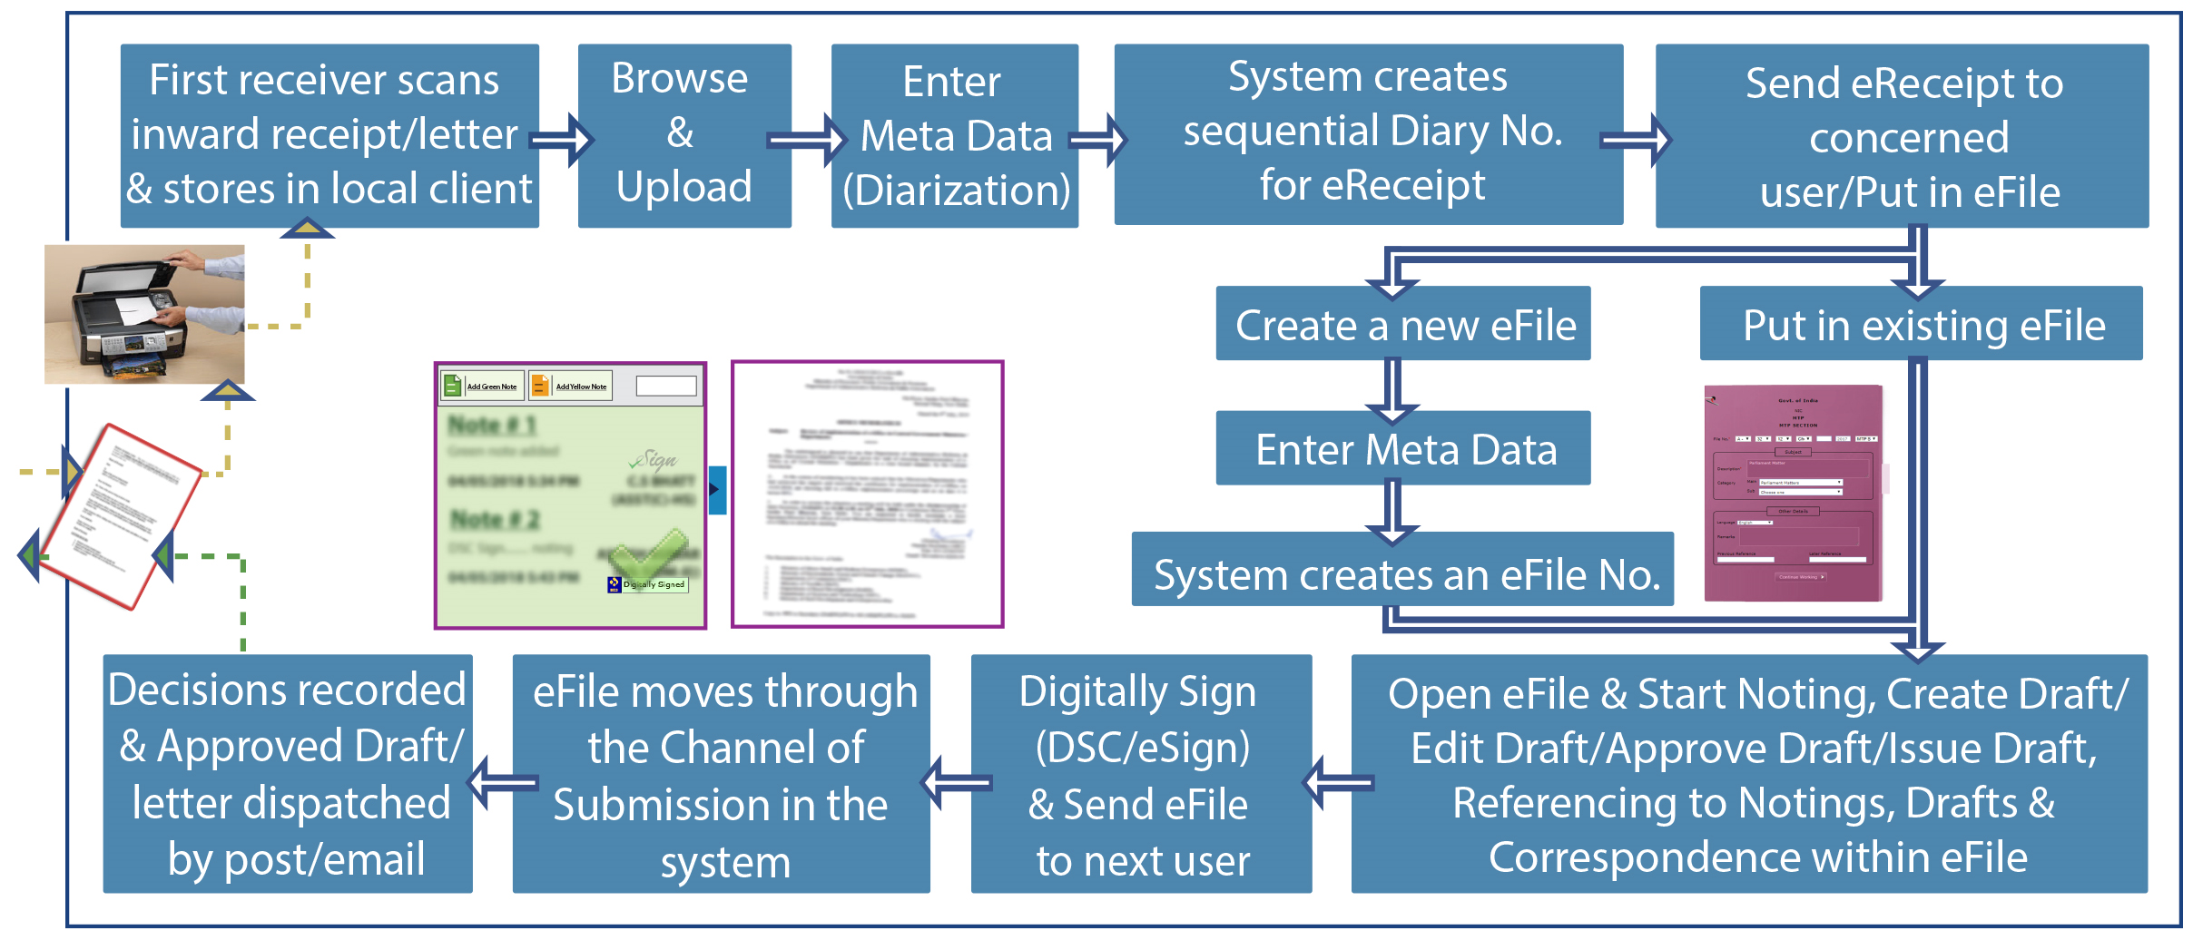
eFile Process

Slide 10
eFile

Slide 11
Knowledge Management System (KMS)
KMS supports the life cycle of documents of an organization, enabling users to create and manage electronic documents that can be viewed, searched, shared and published.
Knowledge Management Portal for an organization is developed with the objective of knowledge sharing and discovery among the users of an organization to enable efficient utilization of knowledge.

Slide 12
KMS Features
Authentication with Single Sign on
Document Workflow and Roles
Content Based OCR Search along with Metadata
Tagging of Document Based on Category, Organisation, Type, Collection
Customized Content and Metadata fields
Subscription and Alerts
Sharing among users

Slide 13
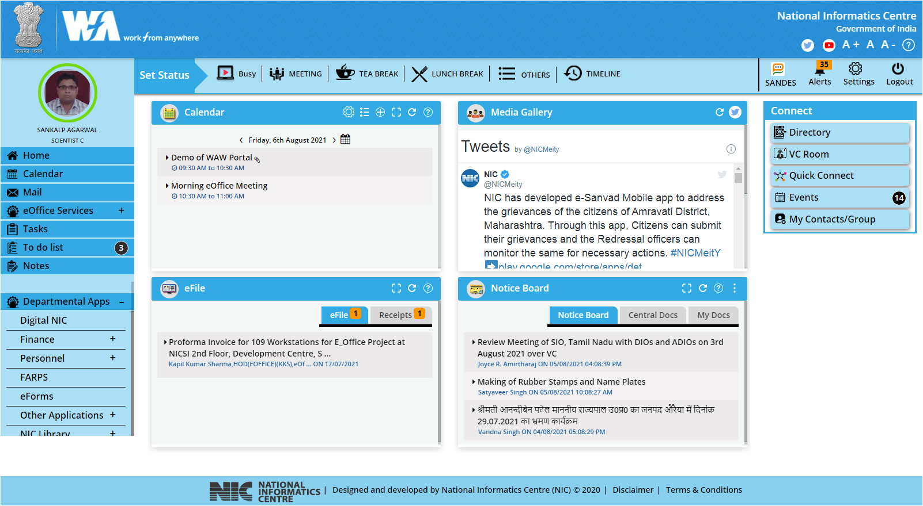

Slide 14
Interface with eGov Systems through API
Employee and Organization Unit (OU) Data Sharing APIs
External
Data Sources
(SAP/ERP/Other Applications)
eOffice-PIMS
Receipt Movements
Receipt Status
eFile Core APIs
Receipt No.
Approved Draft (Mail/Dispatch)
Decisions in eFile
Set Flag for Receipt
External
Application
Receipt Creation
External
Application
eOffice-eFile Application
External Dashboard and Reporting APIs
1. Organization Unit/Employee Pendency
2. OU/Employee Performance
3. CM Dashboard
many more……

Slide 15
Activities involved in eOffice
NIC eOffice Team
Development of eOffice Product Suite
Testing (Functional, Performance, Security)
Migration from older to new eOffice version
Implementation and Rollout
NIC State Centres
NIC DIOs
Local NIC Cells
RailTel
CSC SPV
Capacity Building
Deployment and Operations
Support and Maintenance

Slide 16
Outcomes
Quick Decision Making and Faster Delivery of Services
Access of Files Any Where Any Time
Movement of files in real time irrespective of geographical locations
Delays removed because of transparency and accountability
Reduction in Corruption, Venal Practices and
Red Tapism
Personal priorities/discretions eliminated because of transparency and accountability
Deleting/replacing the notings or tearing of files etc can not be even thought of
Accountability and Transparency
Citizens can track the papers they have submitted to an office. In states like Kerala, a citizen can go to an office between 3-4, to find the status of his paper and where it is pending.
Pendency Monitoring
Environment Friendly
and Go Green Initiative
Tonnes of papers are saved which in turn saves trees
Infrastructure like Printers, Cartridges, Cupboards, Office Spaces are also saved
Saving on Account of travel for transporting of files from one location to other
Always available Files never be lost and stored for perpetuity
Natural Storms, Corona, floods but Government functioning is not at all impacted
Officials could work on their files seamlessly, in secured & safe manner from offices/homes

Slide 17
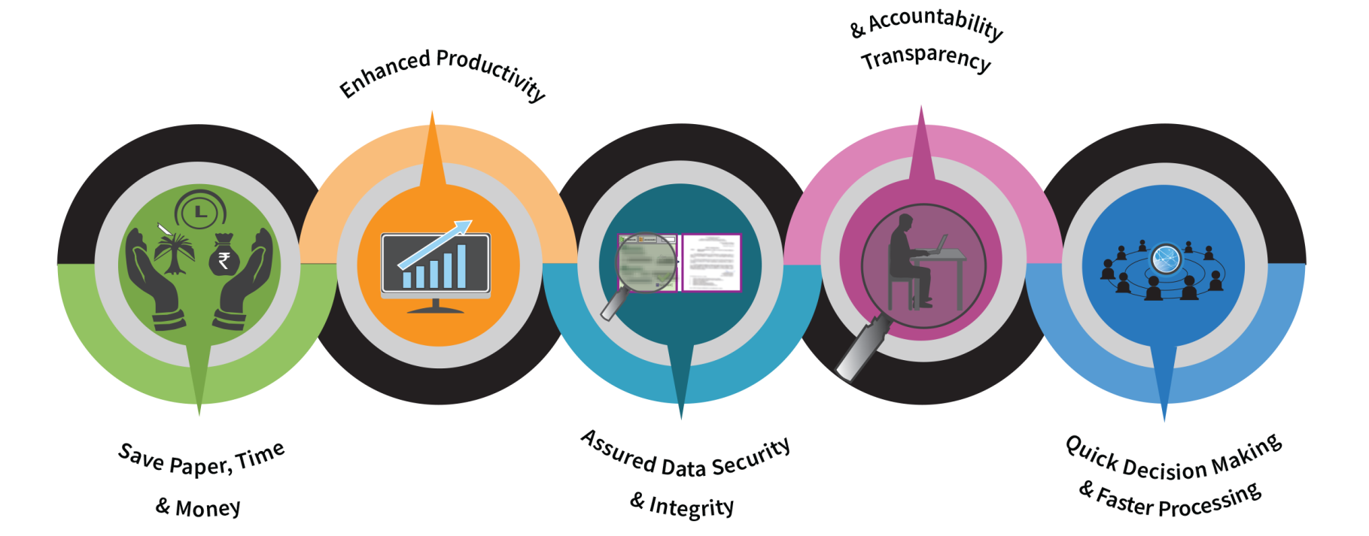
For details :
visit https://eoffice.gov.in
email eoffice-pmu@nic.in

